Slide 1
Movie recommendation algorithm based on sentiment analysis of movie Comments

Slide 2


“Meta-analysis suggests that mood induction by film clips is a highly effective method to generate negative and positive affective reactions.”
Fernández-Aguilar, Luz, et al
A recommendation list of movies to help people against negative moods

Slide 3




















Mood Movie List
Loneliness Film List
Anger Film List
Sadness Film List
Anxiety Film List

Slide 4










Loneliness Film List
Anger Film List
Sadness Film List
Anxiety Film List

Slide 5
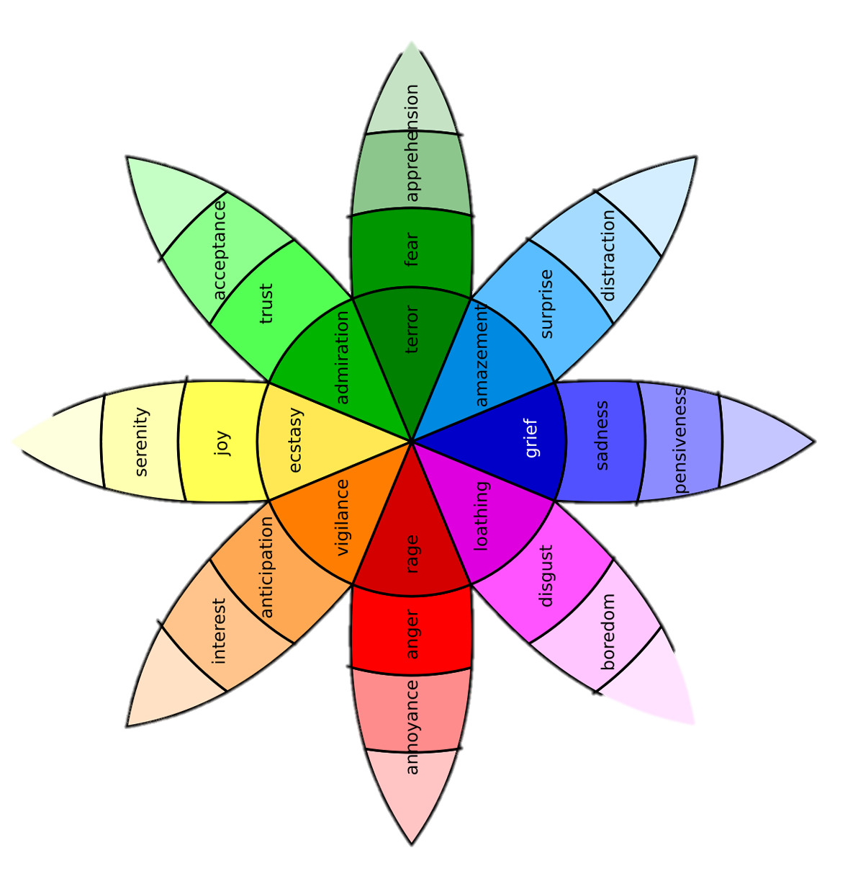
Recommendation Algorithm
Loneliness Film List
IMDB Avg Star Rating
(Quality of Movie)
Anger Film List
Comments Count
(Movie popularity)
Sadness Film List
Emotion Wheel
Plutchik, R. (1980)
Helpful, Random...
Anxiety Film List

Slide 6

“Kaggle is the world's largest data science community. Which allow users explore, analyze, and share quality data.”

Slide 7
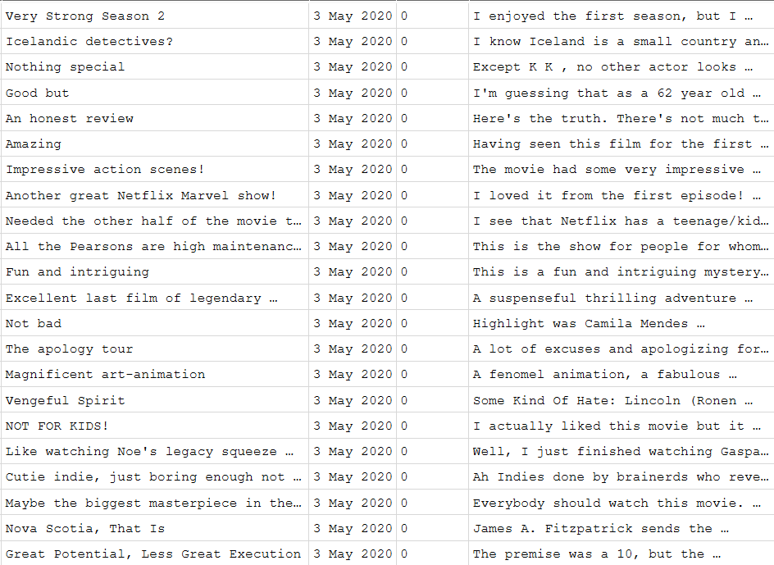
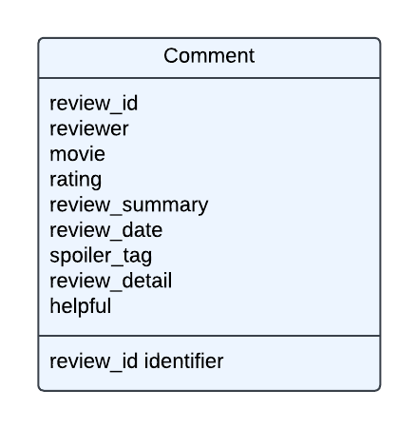
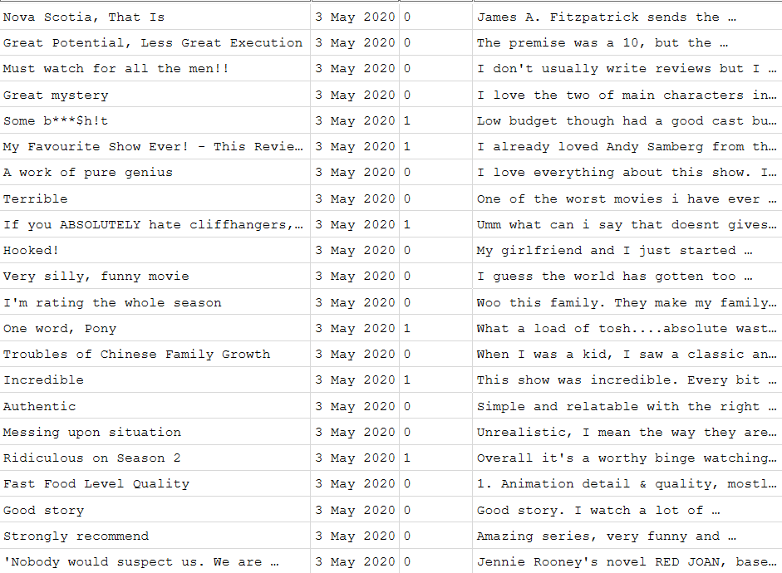

Slide 8





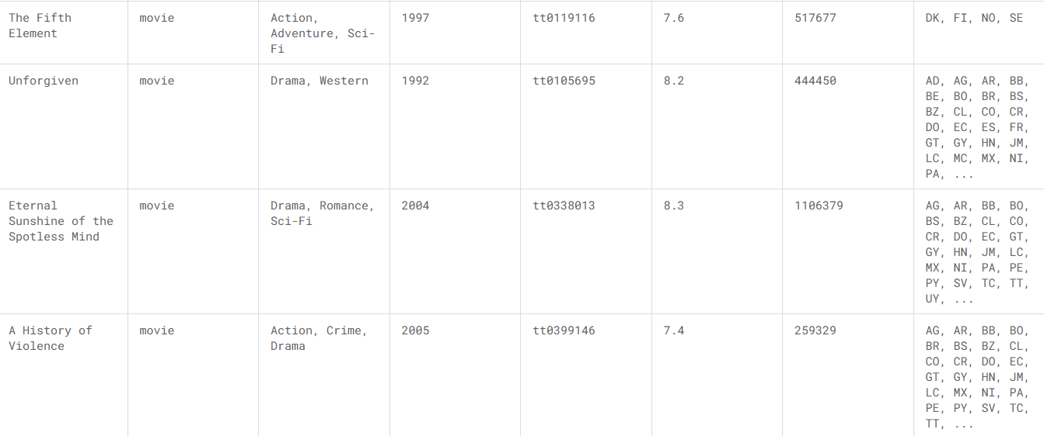
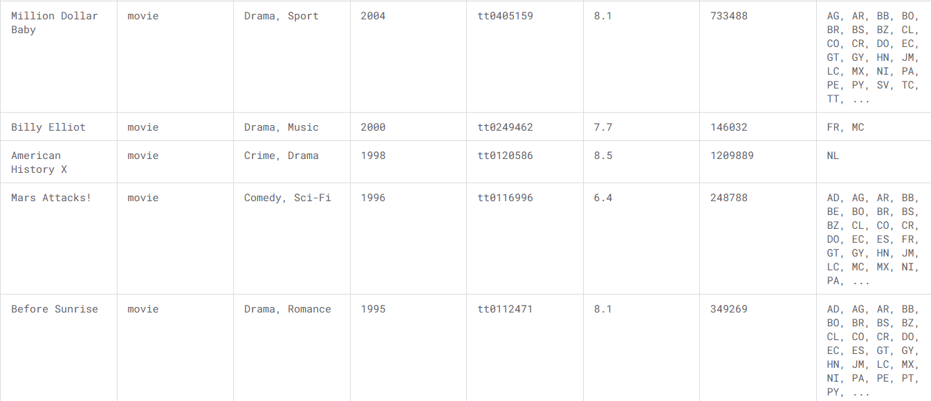
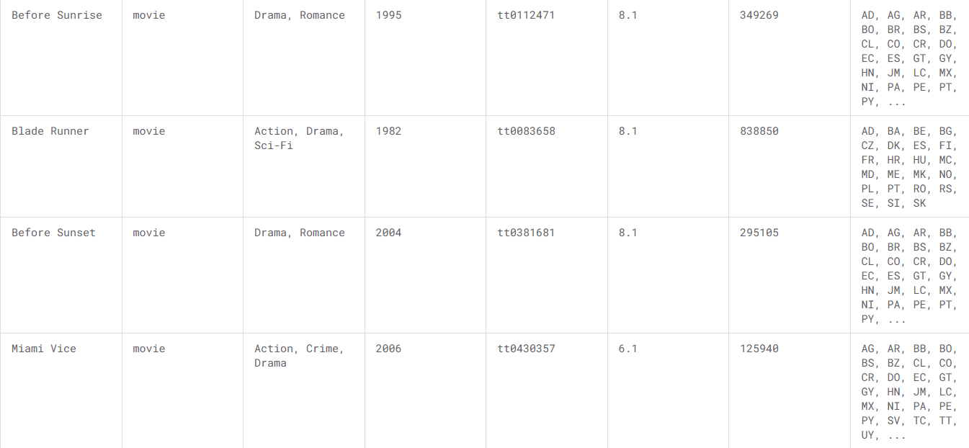
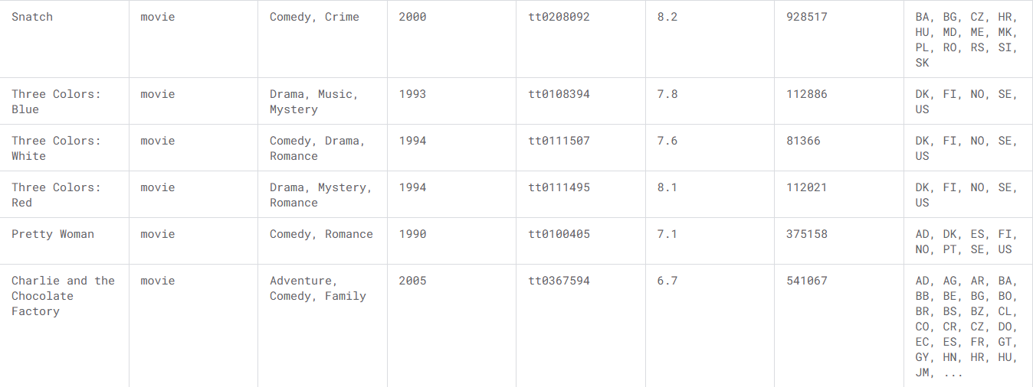

Slide 9
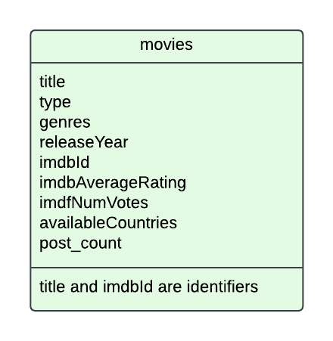
0…*
1

Slide 10

Not using local Storage
Fast in Non-I/O jobs like Json Decoding
“Pandas is a fast, powerful, flexible and easy to use open-source data analysis and manipulation tool,
built on top of the Python programming language.”

Slide 11
Json Decoding & Inserting to DB
📁 comments
├─📄 part-01.json
├─📄 part-02.json
├─📄 part-03.json
├─📄 part-04.json
├─📄 part-05.json
├─📄 part-06.json
5M rows of data

Slide 12
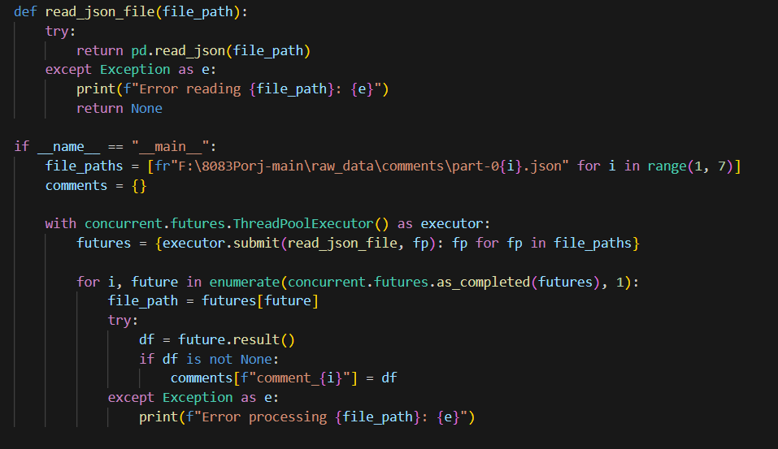
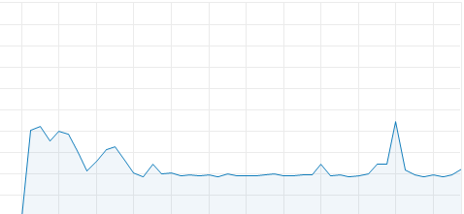
📁 comments
├─📄 part-01.json
├─📄 part-02.json
├─📄 part-03.json
├─📄 part-04.json
├─📄 part-05.json
├─📄 part-06.json
4+ Minutes
Concurrent
Pandas
CPU Usage
100%
0%

Slide 13
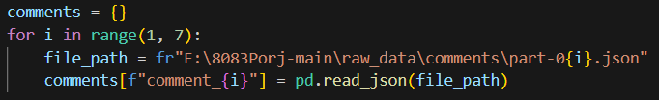
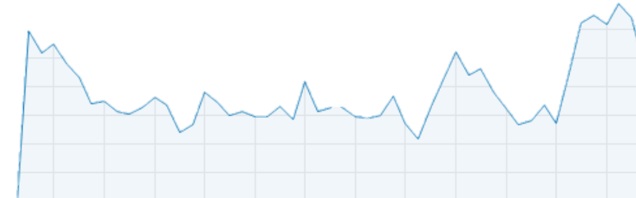
📁 comments
├─📄 part-01.json
├─📄 part-02.json
├─📄 part-03.json
├─📄 part-04.json
├─📄 part-05.json
├─📄 part-06.json
1 Minutes 50 Sec
Concurrent
Pandas
CPU Usage
100%
Pandas
0%

Slide 14


Connect Well With Pandas Data Frame
Spark SQL Supported
“PySpark is the Python API for Apache Spark. It enables you to perform real-time, large-scale data processing in a distributed environment using Python. It also provides a PySpark shell for interactively analyzing your data.”

Slide 15
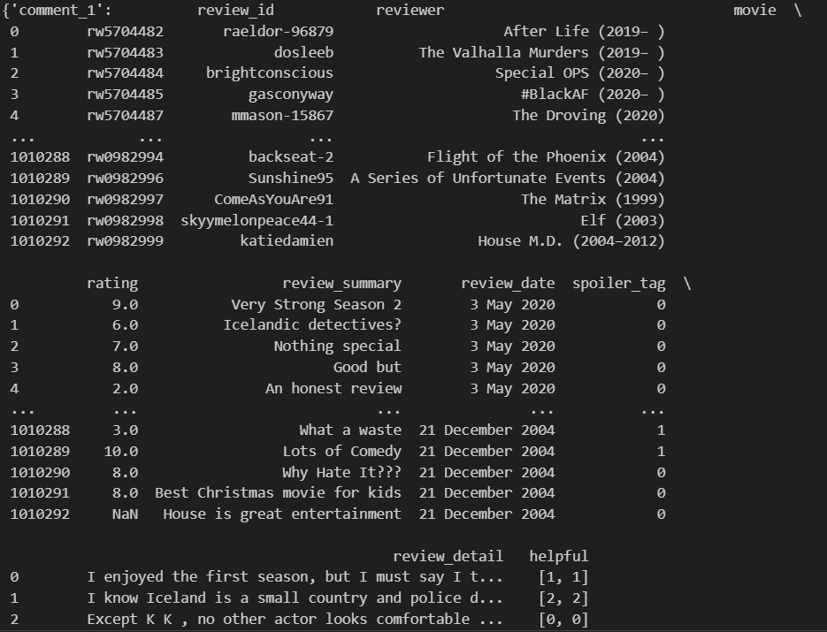
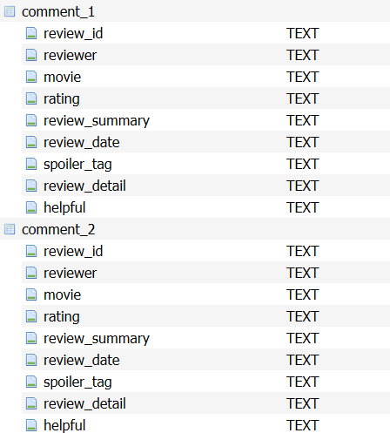
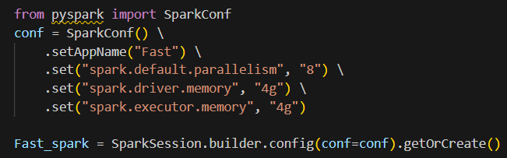
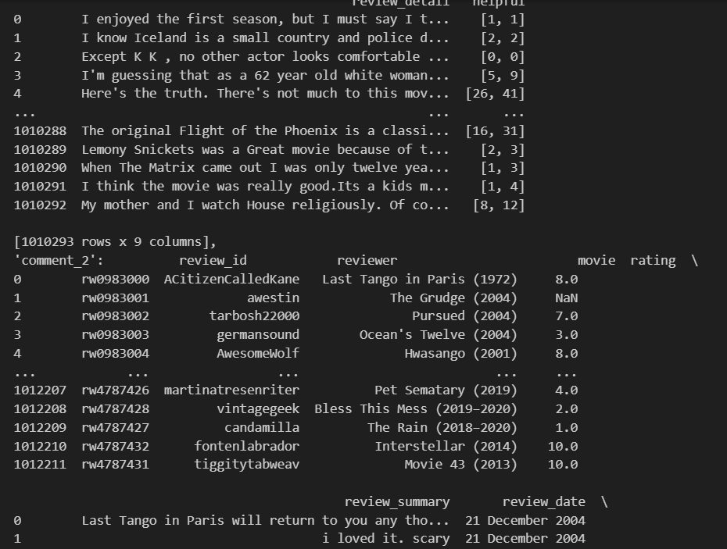
Data frame Dictionary
SQL Database

Slide 16
Data frame Dictionary
Union tables
CREATE TABLE combined_comments AS
SELECT * FROM comment1
UNION ALL
SELECT * FROM comment2
UNION ALL
SELECT * FROM commen3;
SELECT Movie, COUNT(Comments)
FROM combined_comments
GROUP BY Movie;
Comments count/ movie
Avg Star rating
SELECT Movie, avg(rating)
FROM combined_comments
GROUP BY Movie;

Slide 17


Hugging Face
A simple way to launch, train, and use PyTorch models on almost any device and distributed configuration, automatic mixed precision.
PyTorch is a Python package that provides two high-level features:
Tensor computation (like NumPy) with strong GPU acceleration
Deep neural networks built on a tape-based autograd system

Slide 18
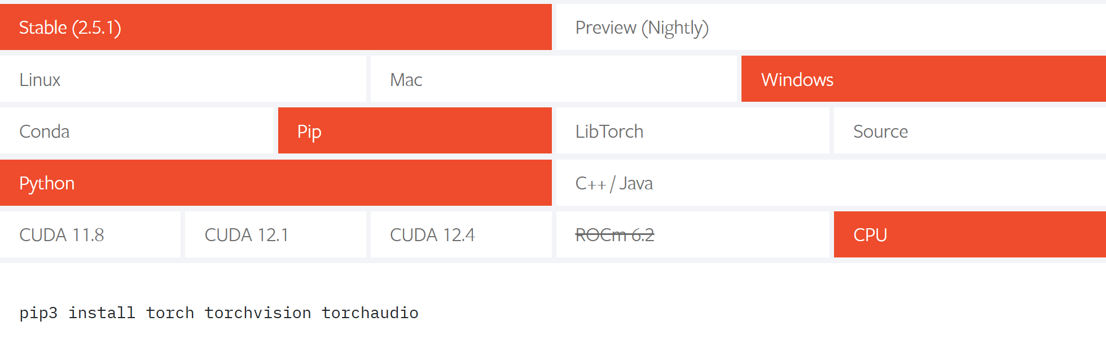

GPU
Parallel Computing

Slide 19
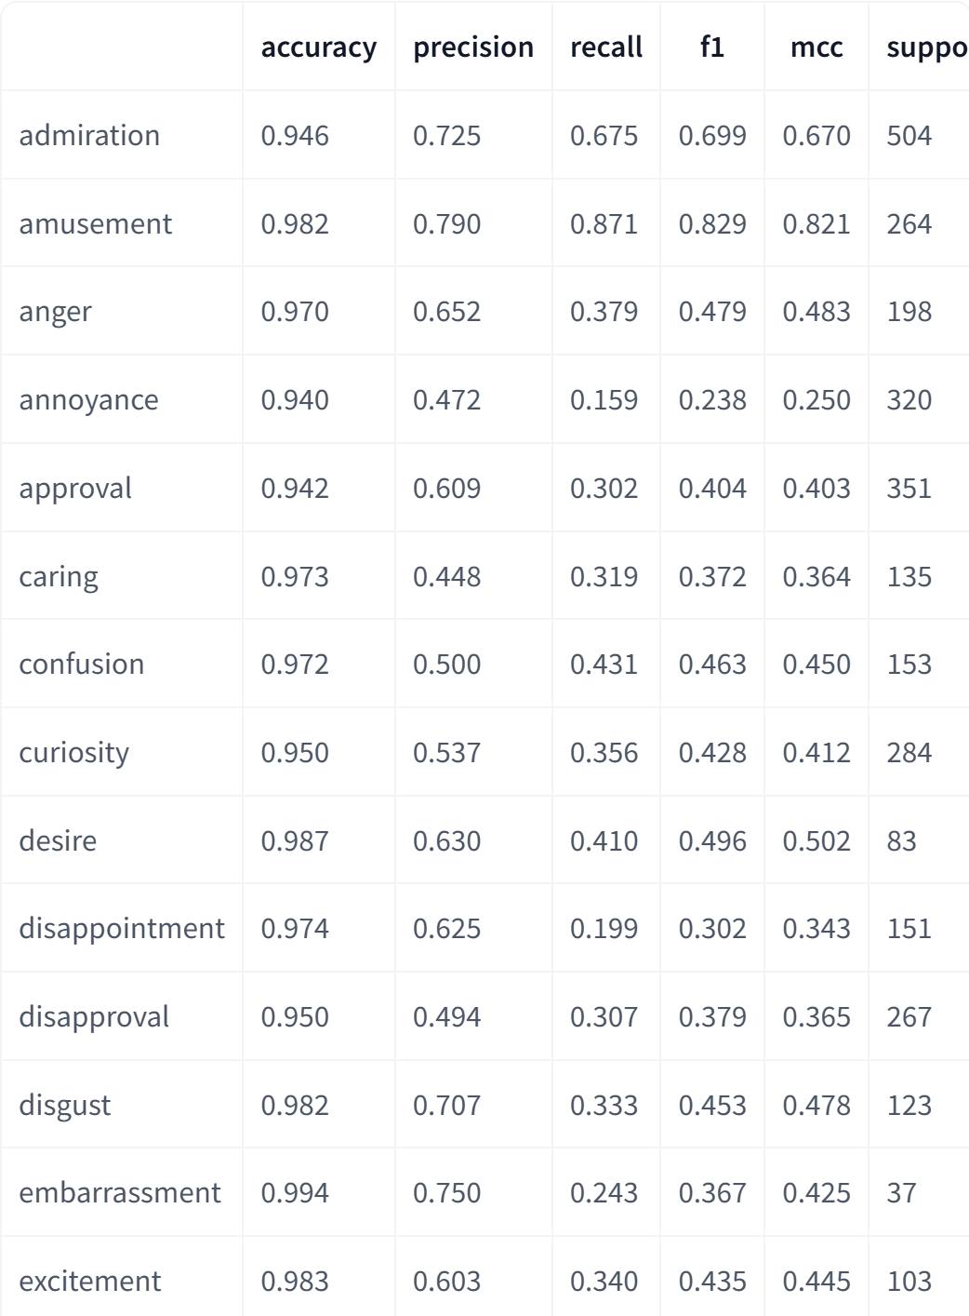
SamLowe/roberta-base-go_emotions
The Author
Model Name
Pre-Train Datasets

Slide 20
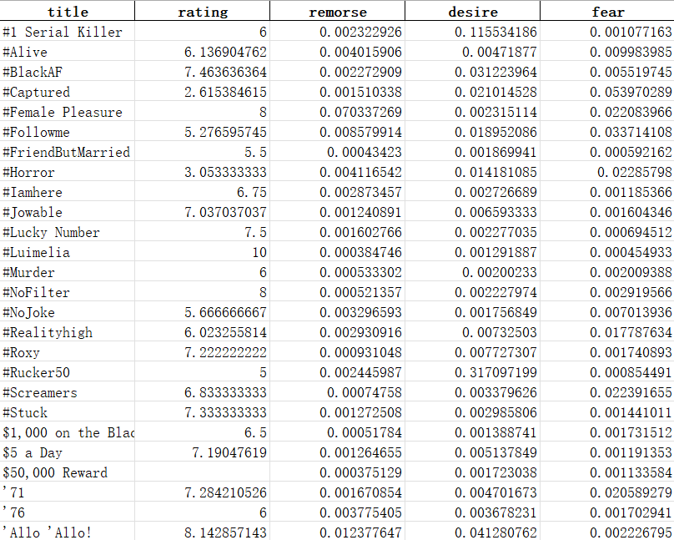
Input
SamLowe/roberta-base-go_emotions
output

